Slide 1
Leveraging Hospitalization to Promote Smoking Cessation in Clinical Settings
Nancy Rigotti, MD
Tobacco Research and Treatment Center,
Massachusetts General Hospital, Harvard Medical School
Rigotti.Nancy@mgh.harvard.edu

Slide 2
Disclosures
Research grant and consultant for Achieve Life Sciences
Royalties from UpToDate
No funding from e-cigarette or tobacco manufacturer
Projects discussed today were funded by NIH or Mass DPH
Notes:
2

Slide 3
Leveraging Tobacco Control Policy to Promote Smoking Cessation in Clinical Settings
Nancy Rigotti, MD
Tobacco Research and Treatment Center,
Massachusetts General Hospital, Harvard Medical School
Rigotti.Nancy@mgh.harvard.edu

Slide 4
Joint Commission for Accreditation of Health Care Organizations (JCAHO; now Joint Commission)
~1990: Hospitals required to have a policy about smoking
Rationale for smoke-free policies: protect nonsmokers
“Unintended” consequences for smokers
Reduced opportunities to smoke
Changed social norms about acceptability of smoking
Led to ↓ tobacco consumption, ↑ smoking cessation
Notes:
4

Slide 5
Hospital admission: a window of opportunity to promote cessation
Illness motivates smokers to try to quit (“teachable moment”)
Smoke-free hospitals require temporary abstinence from tobacco use
Could starting cessation treatment in the hospital improve quit rates after discharge?
Notes:
5

Slide 6
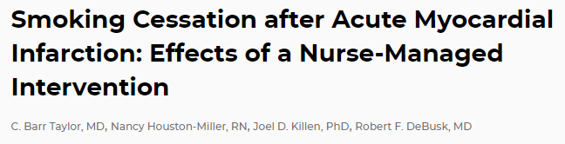
Initial evidence (1990)
Taylor CB et al. Ann Intern Med. 1990; 113:118
RCT showed effectiveness in acute MI patients (vs. usual care)
Nurse counseling began in hospital + phone calls for 3 months after discharge
Biochemically verified 7-day abstinence: 61% vs. 32% at 1 year
Notes:
6

Slide 7
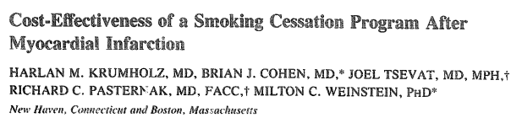
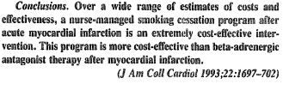
More evidence (1993)
More cost-effective than other secondary cardiac prevention interventions
Notes:
7

Slide 8
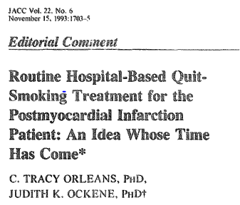
A bold prediction (1993)
Sadly, this did not occur
Research continued…
Could the effect extend to all hospital patients?

Slide 9
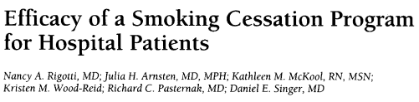
Arch Intern Med. 1997;157(22):2653-2660
650 smokers admitted to Medical or Surgical Services, Mass. General Hospital (1994-95)
Randomly assigned to hospital-based intervention (vs. usual care)
Chart prompt to MD to advise smoking cessation
15 minutes of bedside counseling by a trained counselor
1 brief counselor phone call at 1 week after discharge
No pharmacotherapy (only 4% used NRT in hospital)
Followed 1 and 6 months after discharge

Slide 10
Arch Intern Med. 1997;157(22):2653-2660
Outcome (past 7-day tobacco abstinence, self-report)
1 month: 29% (intervention) vs. 19% (usual care), p= .003
6 months: 17% (intervention) vs. 14% (usual care), p= .26
Conclusion
A low-intensity program ↑ smoking cessation rates for 1 month but not long-term
Could a longer period of telephone contact after discharge extend the effect?

Slide 11
Intervention trials in hospitalized smokers
Cochrane systematic review of interventions that begin in hospital
Rigotti NA, Clair C, Munafo MR, Stead L. Cochrane Library (2002 → updates 2008, 2012)
Bedside counseling followed by telephone support for more than 1 month after discharge increases smoking cessation rates by 37%
It is effective regardless of the reason for admission
It is not effective without >1 month of continued support after discharge
Starting NRT in hospital increases quit rates by 50% (and relieves nicotine withdrawal symptoms)

Slide 12
MGH Tobacco Treatment Service
“Opt-out” program offered to all hospital patients
Step 1: Routine identification of smoking status at admission
RN documents in electronic health record
Step 2: Brief advice to quit, order NRT to manage nicotine withdrawal
Hospital staff responsibility (RN, MD)
Step 3: Smoking cessation counseling at the bedside
Tobacco Treatment Service counselor
- Assess adequacy of withdrawal relief with NRT
- Encourage smoker to commit to quitting, help to make a plan
- Link smoker to resources after discharge

Slide 13
MGH Tobacco Treatment Service
“Opt-out” program offered to all hospital patients
Step 1: Routine identification of smoking status at admission
RN documents in electronic health record
Step 2: Brief advice to quit, order NRT to manage nicotine withdrawal
Hospital staff responsibility (RN, MD)
Step 3: Smoking cessation counseling at the bedside
Tobacco Treatment Service counselor
- Assess adequacy of withdrawal relief with NRT
- Encourage smoker to commit to quitting, help to make a plan
- Link smoker to resources after discharge

Slide 14
Sustaining Treatment after Hospital Discharge
Helping HAND Trials (Hospitals Assist with Nicotine Dependence)
2010 | 2011 | 2012 | 2013 | 2014 | 2015 | 2016 | 2017 | 2018 | 2019 | 2020 | 2021
Helping HAND 1
 |  | Helping HAND 2
 |  |  |  |  | Helping HAND 3
 |  |  |  |  |  |  |  | Helping HAND 4

Slide 15
How can we sustain treatment after hospital discharge?
Sustain medication use
Sustain counseling support

Slide 16
How can we sustain medication use after discharge?
Remove barriers to starting drug immediately
Convenience: give 30 days of medication (not a prescription) at discharge
Cost: Free
Choice: any FDA-approved medication
Remove barriers to using a full course
Cost: Free refills for 90 days of treatment

Slide 17
How can we sustain counseling after discharge?
Telephone calls
Remind patient to stay quit
Offer ongoing counseling for relapse prevention
Encourage adherence to medication
But labor intensive
Automated phone calls (interactive voice response, IVR)
Can triage patients needing a call from a counselor
More efficient than calls by live counselor
Calls can be made outside work hours
Low cost per call once system is set up

Slide 18
Helping HAND 1 Trial
Funding: NIH RC1 HL099668
397 smokers admitted to MGH (2010-2012)
All receive smoking cessation counseling + NRT in hospital
Randomize
Standard Care
N=199
Sustained Care
N=198
Outcomes assessed at 1, 3, and 6-month follow-ups
Tobacco abstinence at 6 months (validated 7-day point prevalence) [1º outcome]
Tobacco abstinence at 1 month, 3 months
Use of tobacco treatment (counseling or pharmacotherapy)
Cost effectiveness (cost/quit)

Slide 19
Helping HAND 1 Trial: Interventions
Sustained Care
30 days of free medication (not just a prescription) at discharge, refillable x 2
5 automated IVR calls (3, 14, 30, 60, 90 days)
At each contact, smoker is offered the option to ask for counselor to call back
Some responses trigger an automatic call back from the live counselor
Standard Care (control)
A specific medication recommendation
Advice to call the state Quitline (free counseling + NRT)

Slide 20
Eligibility
Adult cigarette smoker (>1 cigarette in past week)
Admitted for any diagnosis
Counseled by hospital smoking counselor
Plans to try to quit smoking after discharge
Exclude ongoing substance use disorder
Exclude severe cognitive or psychiatric problems

Slide 21
Enrollment, Follow-up, and Analysis
397 smokers enrolled (2010-2012)
Follow up assessment rates
91% at 1 mo, 85% at 3 mo, 82% at 6 mo
2% mortality
No difference by group
Analysis
Intention to treat analysis
Patients lost to follow-up = smokers
1º outcome requires biochemical validation
Cotinine (saliva sample) or carbon monoxide (breath sample)
Notes:
21

Slide 22
Results: Baseline Characteristics
Control Intervention
N=199 N=198
Age (mean yr) 51 54
Sex (% male) 46 52
White (%) 83 79
Black (%) 5 4
Hispanic (%) 6 6
Cigarettes/day 16 17
Days in hospital (median) 4 5
Tobacco-related disease
discharge diagnosis (%) 45 46
NRT use in hospital (%) 63 66

Slide 23
Intervention Implementation
Feasibility of intervention delivery
65% of IVR calls are answered
>95% got medication at discharge (>95% NRT)
50% request medication refills
Acceptability of the intervention
Patient survey (3 months)
High level of patient satisfaction with IVR calls
Notes:
23

Slide 24
Cumulative Use of Treatment After Discharge
Use Any Medication
Use Any Counseling
P<.05 for all
comparisons

Slide 25
Tobacco Abstinence after Discharge - Past 7 days
Self Report
Biochemically Confirmed
RR 1.33 (1.07-1.65)
Primary outcome measure
Conclusion
Sustained Care was superior to Standard Care for post-discharge care of hospitalized smokers
Cost-effectiveness Yr1 Yr2
Cost/quit $3217 $997
Cost/patient $354 $108
RR 1.23 (0.96-1.56)
60
RR 1.45 (1.10-1.92)
60
52
50
45
50
RR 1.71 (1.14-2.56)
39
41
40
37
40
% Abstinent
28
30
30
26
% Abstinent
20
20
15
10
10
0
1 mo
3 mo
6 mo
0
6 mo
p=.012
p=.10
p=.008
p=.009
Control

Slide 26
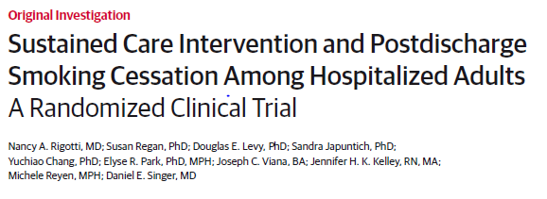
JAMA 2014; 312:719

Slide 27
Limitations
Single site study
Generalizable to other hospitals, other geographic regions?
Intervention scalability
How could this be done at scale?
Sustainable after grant funding ends?
Notes:
27

Slide 28
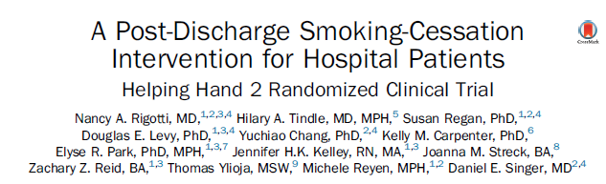
Helping HAND 2 Trial NIH/NHBLI R01 HL111821
mPI: Rigotti / Tindle
Am J Prev Med 2016;51(4):597–608

Slide 29
Innovations for Helping HAND 2
1- Test generalizability of the intervention
Conduct a multi-site trial (3 hospitals)
MGH
Small community hospital (Salem, MA)
Large academic center in another region (Univ. of Pittsburgh Med. Ctr.)
Broaden eligibility
Enroll patients with substance use disorders other than tobacco
Notes:
29
29

Slide 30
Innovations for Helping HAND 2
2- Increase scalability of the intervention
Reduce cost → Use Quitlines for post-discharge counseling
Free community-based resource funded by state public health depts.
5 proactive calls from tobacco coach to smoker, coordinated with quit date
NRT sample
IVR call → Patient requests or needs more help → refer to a Quitline coach
Streamline intervention delivery
Real-time “warm transfer” from IVR vendor to Quitline vendor
Notes:
30
30

Slide 31
Helping Hand 2 Trial Enrollment conducted 2012-2014
Sustained
Notes:
31

Slide 32
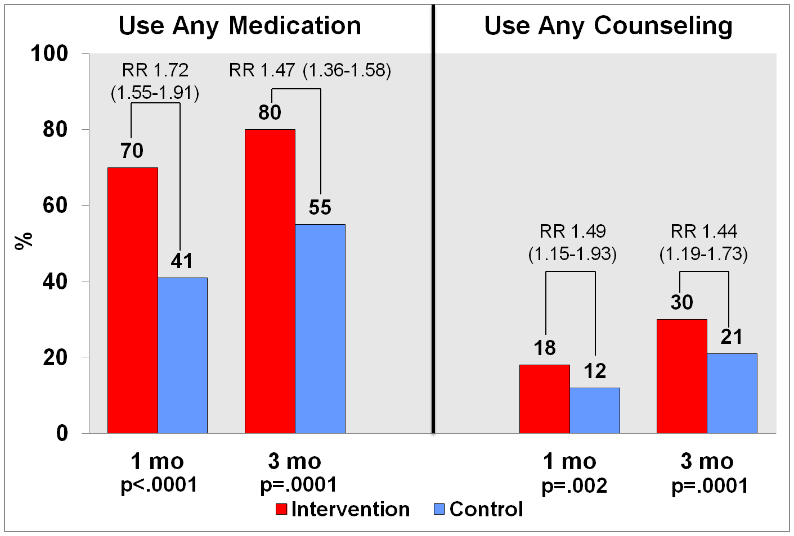
Cumulative Use of Treatment After Discharge
Notes:
32
32

Slide 33
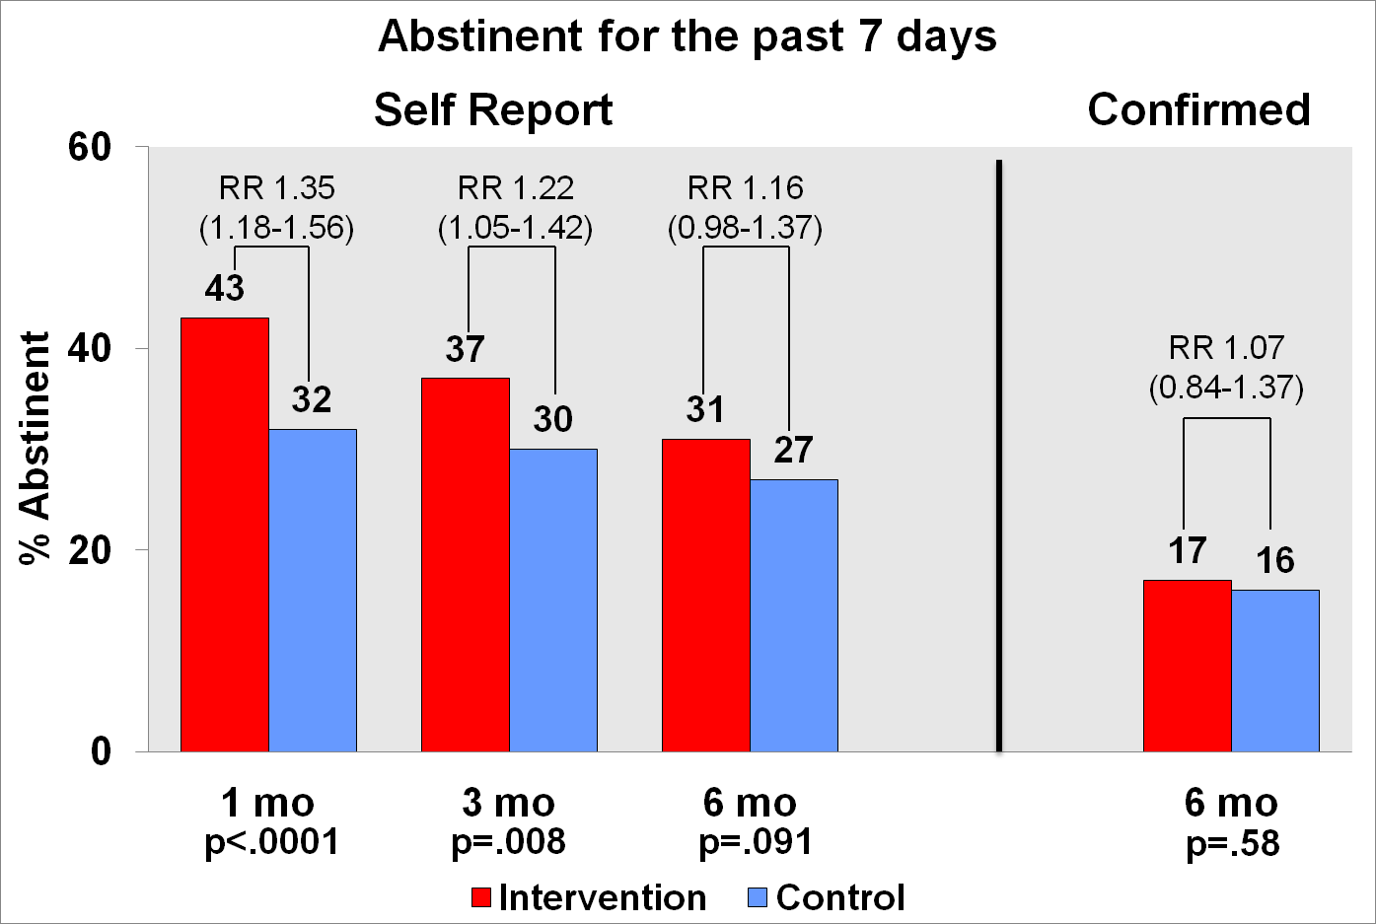
Tobacco Abstinence After Discharge

Slide 34
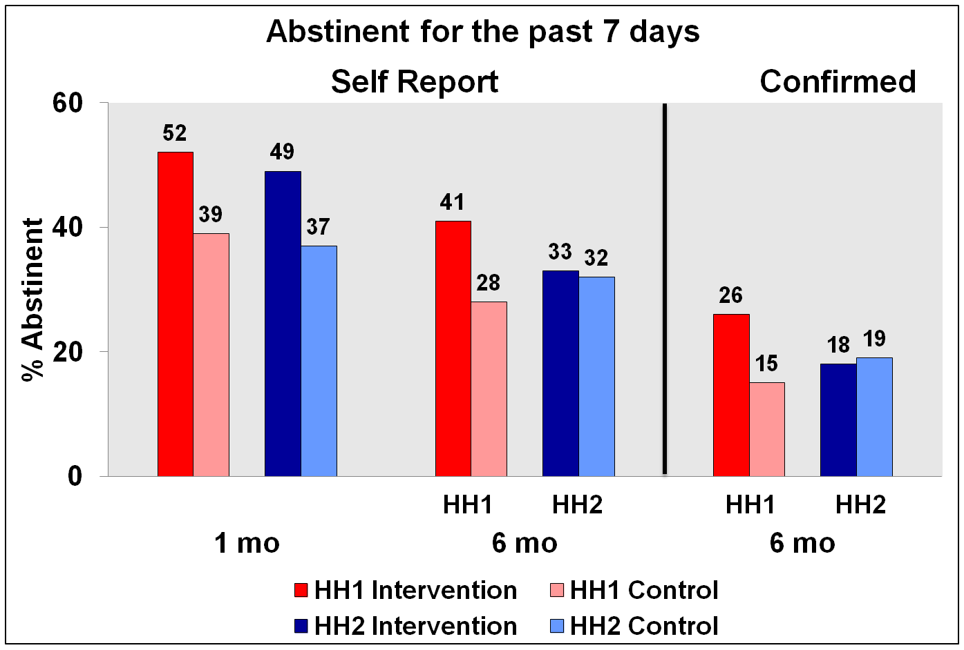
Helping HAND 1 vs. Helping HAND 2 (MGH Data)

Slide 35
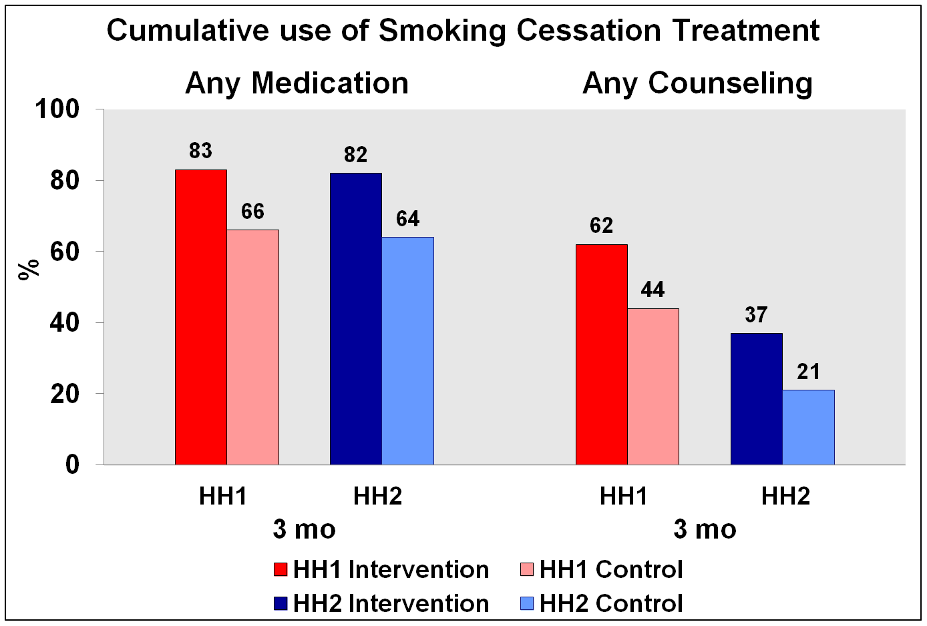
Helping HAND 1 vs. Helping HAND 2 (MGH Data)

Slide 36
Why did the effect disappear?
IVR acceptance was similar in both studies
Medication use was similar in both studies
Fewer smokers used counseling in HH2 than in HH1
Linking directly from IVR call to quitline provider required 2 steps and resulted in fewer patients receiving counseling
The intervention was weakened by modification made to increase its scalability.
Conclusion
Notes:
36

Slide 37
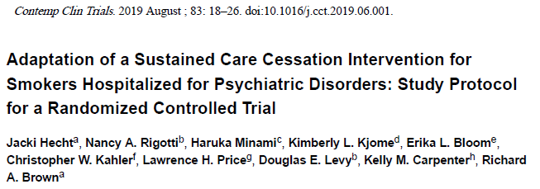
Helping HAND 3 Trial
NIMH 1R01-MH104562.
mPIs: Rick Brown, Nancy Rigotti

Slide 38
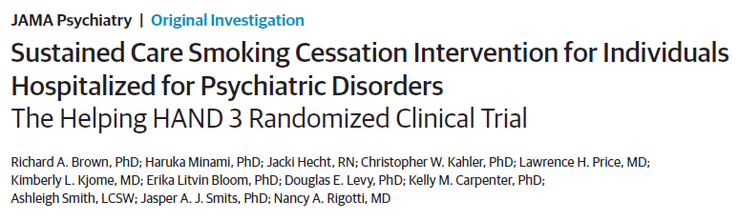
Site: 1 psychiatric hospital in Texas
Enrollment: 2015-2019
JAMA Psychiatry
doi:10.1001/jamapsychiatry.2021.0707
Published online May 5, 2021.

Slide 39
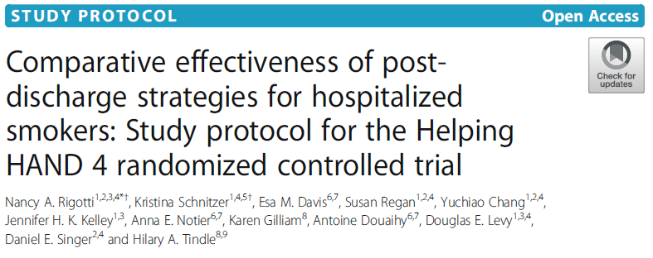
Helping HAND 4 Trial:
“Back to the Future”
NIH/NHBLI R01 HL111821
mPI’s: Rigotti / Tindle
Rigotti et al. Trials (2020) 21:336
https://doi.org/10.1186/s13063-020-04257-7

Slide 40
Comparative effectiveness trial Hospital-based program vs. referral to community resource
Hospital-based intervention: effective in Helping HAND 1 trial
IVR calls → hospital-based counselor
Counselor takes on care coordination role → link smoker to PCP
Medication: NRT only, for 8 weeks
Community-based intervention: bi-directional eReferral to Quitline
eReferral from EHR → Quitline → Staff directly contacts smoker
Quitline staff provides counseling, offers NRT sample
Report of referral outcome → sent back to EHR
Hypothesis: Hospital-based program will be more effective but more costly
Notes:
40

Slide 41
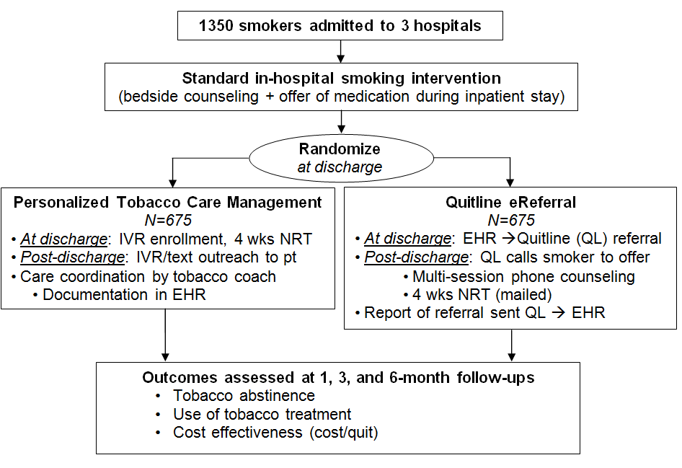
Helping HAND 4
Trial
3 hospitals:
MGH
Univ. Pittsburgh
Vanderbilt Univ.
Enrollment:
2018-2020
Hospital
8

Slide 42
Sustaining Treatment after Hospital Discharge
Helping HAND (Hospitals Assist with Nicotine Dependence) Trials
Helping HAND Trials | 2010 | 2011 | 2012 | 2013 | 2014 | 2015 | 2016 | 2017 | 2018 | 2019 | 2020 | 2021
HH1 | Test the initial model
HH2 |  |  | Expand and Scale Up
HH3 |  |  |  |  |  | Adapt to a more vulnerable population
HH4 |  |  |  |  |  |  |  |  | Compare two models

Slide 43
Summary
Hospital admission is a teachable moment for starting tobacco treatment
Engaging smokers in counseling after discharge remains a challenge
Late relapse remains a barrier because tobacco use is a chronic disease
The real need is a coordinated cost-effective health care system strategy
To recognize tobacco use as a chronic disease
To use the tools of chronic disease management
And also intervene at events that serve as teachable moments

Slide 44
Thanks to the Helping HAND team members
University of Texas, Austin
Richard Brown, PhD
Jackie Hecht
Tobacco counselors and research staff
MGH
Yuchiao Chang, PhD
Jennifer Kelley, DNP
Kathleen McKool, RN, MSN
Gina Kruse, MD
Doug Levy, PhD
Elyse Park, PhD
Susan Regan, PhD
Michele Reyen, MPH
Kristina Schnitzer, MD
Daniel Singer, MD
Tobacco Treatment Service counselors and research staff
Vanderbilt University
Hilary Tindle, MD, MPH
Karen Gillam
Tobacco Treatment Service counselors and research staff
University of Pittsburgh
Esa Davis, MD
Anna Notier
Antoine Douaihy, PhD
Thomas Ylioja, PhD
Tobacco Treatment Service counselors and research staff
Notes:
44

Slide 45
Thank you
Nancy Rigotti, MD
Massachusetts General Hospital, Harvard Medical School
Rigotti.Nancy@mgh.harvard.edu

